Slide 1

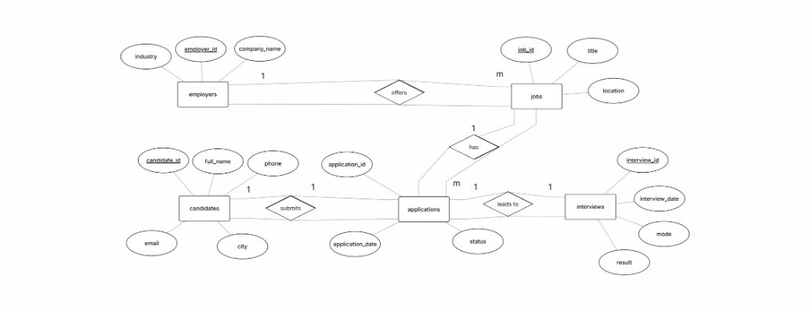

job-portal.sql
PROJECT GUIDE
Overview
MYSQL CAPSTONE PROJECT
Job Portal
Schema
SQL Techniques
Management
RESOURCES
System
ER_MODEL.png
diagram loaded
Business Queries
Advanced SQL
A relational database for candidates,
employers, jobs, applications and
interviews.
Project Team
PRESENTED BY
1. A Megha Srinath
2. M Siddhardha
3. R Yuvaraj
slide 01 / 12
01
MySQL Capstone Project

Slide 2
job-portal.sql
PROJECT OVERVIEW
Project Objective
PROJECT GUIDE
Overview
Design and implement a Job Portal database using MySQL to manage the complete
hiring workflow.
Schema
SQL Techniques
01
02
03
RESOURCES
Business Queries
Centralize records
Track applications
Support decisions
Advanced SQL
Keep candidate, employer
and job information in related
tables.
Follow application dates and
statuses from Applied to
Selected.
Use SQL queries, views and
transactions to answer
business questions.
Project Team
Scope: candidates · employers · jobs · applications · interviews
slide 02 / 12
02
MySQL Capstone Project

Slide 3

job-portal.sql
DATA MODEL
DataBase Schema Overview
PROJECT GUIDE
Overview
Five connected tables represent the hiring journey from job posting to
interview result.
Schema
SQL Techniques
Candidates
Employers
RESOURCES
candidate_id PK · full_name · phone
UNIQUE · email UNIQUE · city
employer_id PK · company_name ·
industry
Business Queries
Advanced SQL
Jobs
Applications
Project Team
job_id PK · employer_id FK · title ·
location · salary
application_id PK · candidate_id FK ·
job_id FK · application_date · status
Interviews
interview_id PK · application_id FK ·
interview_date · mode · result
PK identifies each record.
FK connects related tables.
slide 03 / 12
03
MySQL Capstone Project

Slide 4
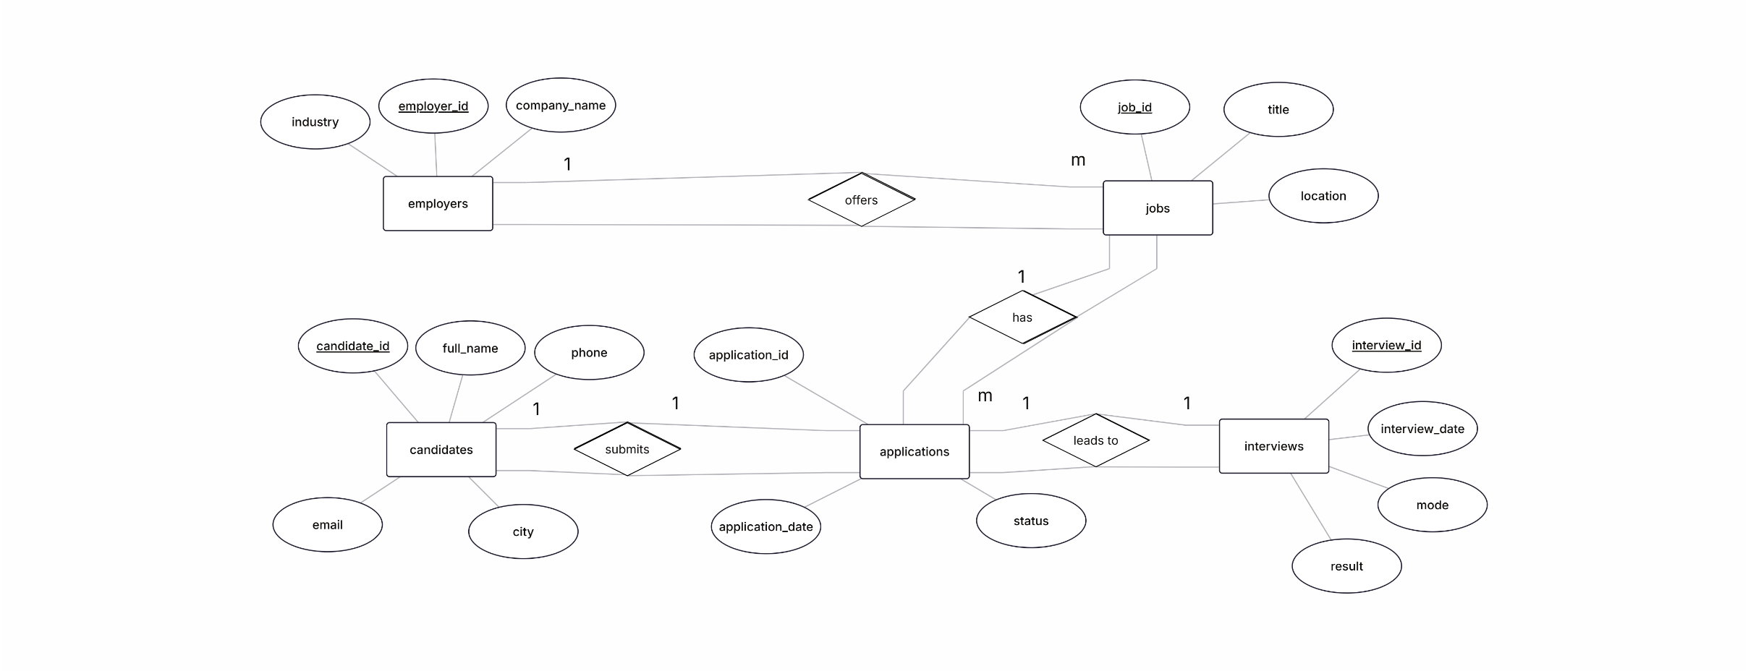
job-portal.sql
VISUAL SCHEMA
Entity Relationship
PROJECT GUIDE
Overview
Diagram (ER Diagram)
Schema
Relationships show how employers offer jobs, candidates submit applications, and
applications lead to interviews.
SQL Techniques
RESOURCES
Business Queries
Advanced SQL
Project Team
slide 04 / 12
04
MySQL Capstone Project

Slide 5

job-portal.sql
QUERY FUNDAMENTALS
Basic SQL / SELECT / WHERE
PROJECT GUIDE
Overview
Retrieve only the fields and rows needed for a business question.
Schema
SQL Techniques
Core pattern
SELECT job_id, title, location,
RESOURCES
SELECT chooses columns. WHERE
filters rows before the result is
returned.
salary
FROM Jobs
Business Queries
WHERE location = 'Hyderabad'
Advanced SQL
AND salary > 600000;
Project Team
Example question: Which
Hyderabad jobs offer more than
₹600,000?
SELECT *
FROM Jobs;
slide 05 / 12
05
MySQL Capstone Project

Slide 6
job-portal.sql
QUERY FUNDAMENTALS
AGGREGRATE FUNCTIONS
PROJECT GUIDE
Overview
Summarize rows into useful counts, totals and averages for decision-making.
Schema
SQL Techniques
COUNT()
AVG()
SELECT e.company_name,
COUNT(j.job_id) AS total_jobs,
RESOURCES
jobs per
company
average
salary
AVG(j.salary) AS average_salary
Business Queries
FROM Employers e
Advanced SQL
JOIN Jobs j ON e.employer_id =
SUM()
MIN /
MAX
j.employer_id
Project Team
GROUP BY e.company_name
salary
budget
ORDER BY total_jobs DESC;
salary
range
slide 06 / 12
06
MySQL Capstone Project

Slide 7
job-portal.sql
QUERY FUNDAMENTALS
String, Numeric & Date Functions
PROJECT GUIDE
Overview
Functions transform stored values into readable output for reports and analysis.
Schema
SQL Techniques
String
Numeric
Date
RESOURCES
UPPER(company_name)
LOWER(company_name)
CONCAT(full_name, '
— ', city)
REPLACE(title,
'Engineer',
ROUND(AVG(salary),
0)
MIN(salary)
MAX(salary)
SUM(salary)
DATE_FORMAT(
Business Queries
application_date,
'%a-%b-%y'
Advanced SQL
)
Project Team
DATEDIFF(CURDATE(),
application_date)
'Specialist')
slide 07 / 12
07
MySQL Capstone Project

Slide 8

job-portal.sql
RELATIONAL QUERIES
JOINS
PROJECT GUIDE
Overview
Combine related tables so one result can show the candidate, company and
job together.
Schema
SQL Techniques
Candidates
→
Applications
→
Jobs
→
Employers
RESOURCES
Business Queries
INNER JOIN
Advanced SQL
SELECT c.full_name,
Returns records that match across
the connected tables.
e.company_name,
Project Team
j.title
Business query: display
candidate name, company name
and job title for every
application.
FROM Candidates c
JOIN Applications a ON c.candidate_id
= a.candidate_id
JOIN Jobs j ON a.job_id = j.job_id
JOIN Employers e ON j.employer_id =
e.employer_id;
slide 08 / 12
08
MySQL Capstone Project

Slide 9

job-portal.sql
ADVANCED SQL
SUBQUERY
PROJECT GUIDE
Overview
A query inside another query helps compare records against a calculated result.
Schema
SQL Techniques
Nested logic
SELECT c.full_name, j.title, j.salary
RESOURCES
The inner query finds the
highest salary. The outer query
returns candidates who applied
for that job.
FROM Candidates c
Business Queries
JOIN Applications a ON c.candidate_id =
a.candidate_id
Advanced SQL
JOIN Jobs j ON a.job_id = j.job_id
Project Team
WHERE j.salary =
( SELECT MAX(salary)
Inner query → comparison
value
Outer query → final records
FROM Jobs
);
slide 09 / 12
09
MySQL Capstone Project

Slide 10

job-portal.sql
REUSABLE QUERY LAYER
VIEWS
PROJECT GUIDE
Overview
Save a frequently used query as a virtual table that can be queried like a
regular table.
Schema
SQL Techniques
Create a view
Retrieve from the view
RESOURCES
Business Queries
CREATE VIEW Selected_Candidates
SELECT *
FROM Selected_Candidates;
AS
Advanced SQL
SELECT c.full_name,
Project Team
e.company_name,
The view keeps a useful business result
readable and reusable without repeating
the full join.
j.title
FROM Candidates c
JOIN Applications
a ON c.candidate_id =
a.candidate_id
JOIN Jobs j ON a.job_id =
j.job_id
JOIN Employers
e ON j.employer_id =
slide 10 / 12
10
e.employer_id
MySQL Capstone Project
WHERE a.status = 'Selected';

Slide 11
job-portal.sql
DATA SAFETY
TRANSACTIONS
PROJECT GUIDE
Overview
Group related changes so they either complete together or can be reversed safely.
Schema
SQL Techniques
COMMIT path
ROLLBACK path
RESOURCES
START TRANSACTION;
START TRANSACTION;
Business Queries
Advanced SQL
UPDATE Applications
SET status = 'Interview
Scheduled'
WHERE application_id = 4;
DELETE FROM Applications
WHERE application_id = 10;
Project Team
ROLLBACK;
COMMIT;
Use COMMIT when the operation is correct. Use ROLLBACK after an accidental change.
slide 11 / 12
11
MySQL Capstone Project

Slide 12

job-portal.sql
PROJECT GUIDE
Overview
Schema
SQL Techniques
JOB PORTAL MANAGEMENT SYSTEM
RESOURCES
THANKYOU
Business Queries
Advanced SQL
Project Team
MySQL schema, relationships and SQL techniques for a
complete job portal workflow.
Presented by
A Megha Srinath · M Siddhardha · R Yuvaraj
slide 12 / 12
12
MySQL Capstone Project

